Slide 1
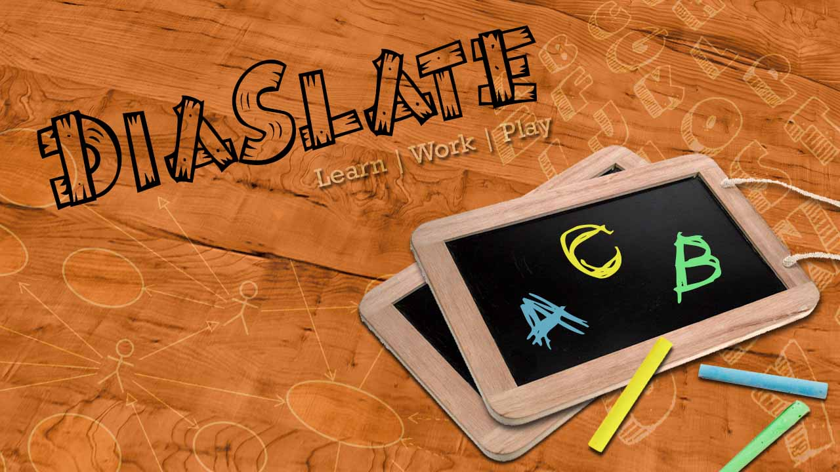
DIASLATE
INTERNS 2013

Slide 2
Our Team
Amandeep Singh
Amit Kumar
Chandrashekhar Bobade
Naveen Kumar
Nishant Kumar
Parlapalli Vinod
Vanya Kandlakunta
Vikram Kore

Slide 3
Our MENTORs
Mr. Parag Tiwari
Mr. Ninad Chilap
Mr. Arun Nair

Slide 4
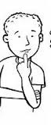
DIASlate-purpose
Emulation of a real slate for children, which can be extended for adults
Means of learning and practicing by writing anything
User-friendly interface for drawing
save as pdf and addition of dynamic pages
Wow It has Dual Feature !!!

Slide 5
DIASlate-features
contains both SLATE and UML (diagram Feature)
Dynamic Pages: allow user to add any no. of pages
Select brush, draw, paint and change any color, width etc.
Select shape: choose from a number of shapes
Text Settings and Drag and Drop shape
Save as image as well as pdf

Slide 6
Why diaslate
diaslate is the only App with dual feature which is open source. The app consist of two parts Slate and Uml which can support writing , drawing flow chart etc.

Slide 7
Target users
Children
Professors in universities
School Teachers
Anybody who wants to draw

Slide 8
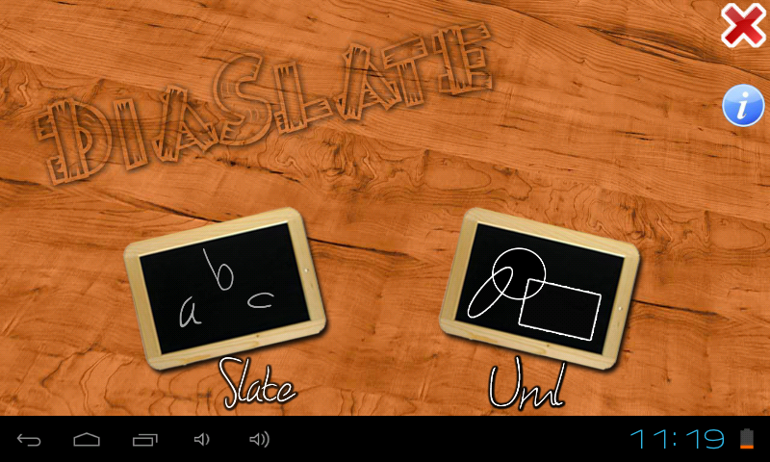
Main application

Slide 9
Slate Application on tablet

Slide 10
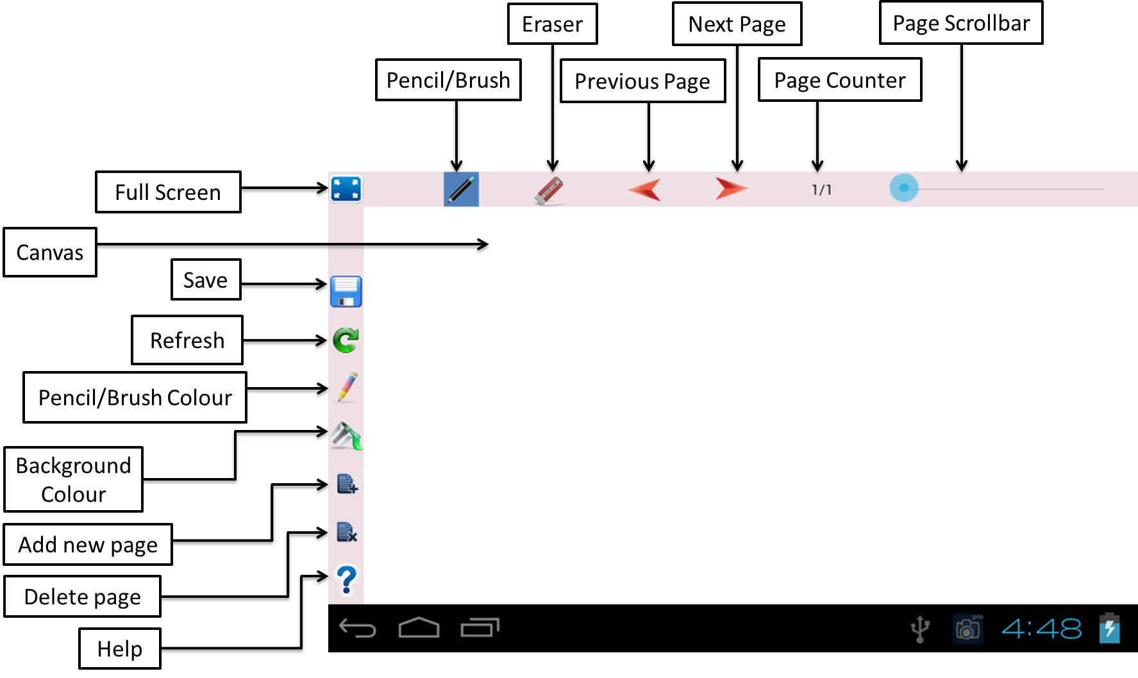
features

Slide 11
uml Application on tablet

Slide 12
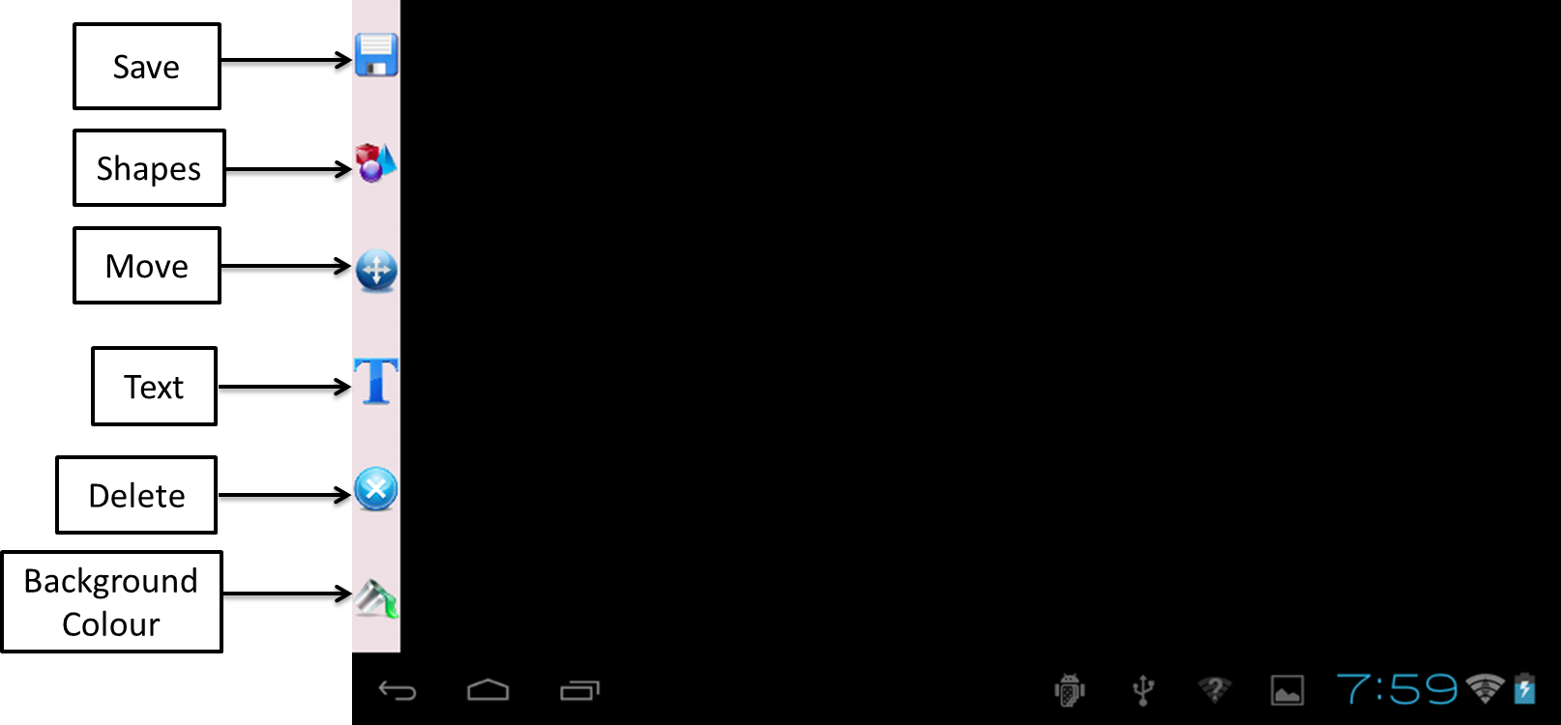
features

Slide 13
comparison
Feature | Blackboard HD | Diaslate
Open Source | No | Yes
Dual Feature | No | Yes
Save as Pdf | No | Yes
Dynamic Pages | No | Yes
Free | Yes | Yes

Slide 14
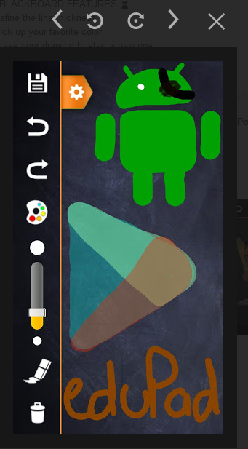
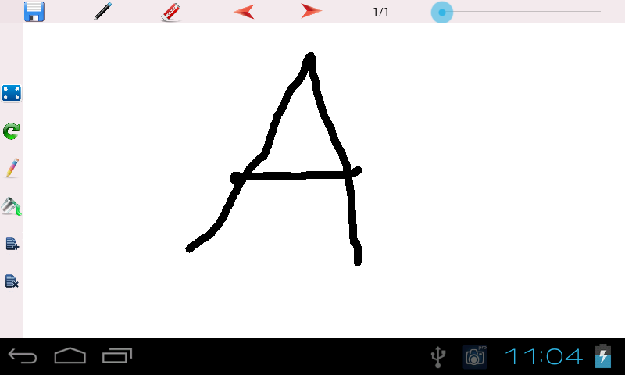
Blackboard hd v/s diaslate

Slide 15
challenges
Resolved
Text Editing inside a shape
Shape Drag and drop
Unresolved
Gesture Detection in slate
Single Zoom able shape
Connectivity of
shape
Unable to move shapes with connectivity

Slide 16
Future enhancements

Slide 17
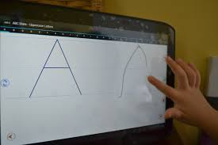
Finger tracing aided by optional follow-the-dot lines for each letter.

Slide 18
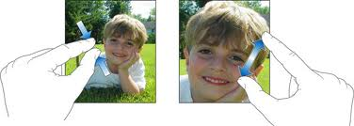
Pinch zoom of single image

Slide 19
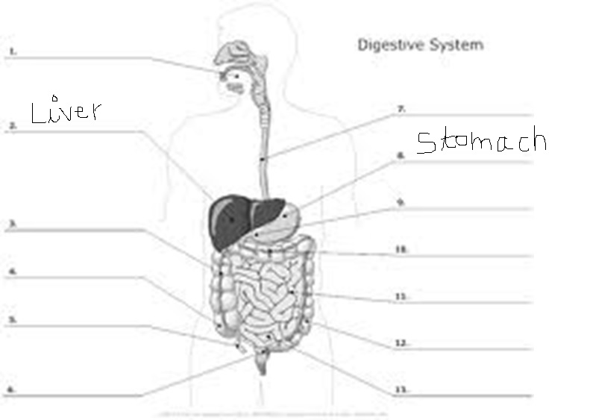
Inserting of images for additional explanation.

Slide 20
references
Android Developer Website, http://developer.android.com
http://som-itsolutions.blogspot.in/2010/12/freeware-android-paint.html
http://www.vogella.com/articles/Android/article.html
http://www.coreservlets.com/android-tutorial/
http://www.github.com

Slide 21
thanks
Amandeep
Amit Kumar
Naveen Kumar
Nishant Kumar
Chandrashekhar
Vanya Kandlakunta
Vikram Kore
Vinod Parlapalli

